Slide 1




Arpit Tamrakar

Slide 2

Vidarbha data weather forecasting using machine learning algorithm integrated with power bi dashboard

Slide 3
The project aims to create an advanced weather forecasting system for Vidarbha, employing machine learning (ML) and deep learning (DL) algorithms and integrating them into a Power BI dashboard. The endeavor encompasses several stages: data compilation from meteorological sources for all 11 districts, followed by meticulous preprocessing to handle anomalies. Subsequently, a Power BI dashboard is constructed, illustrating the amalgamated average values of historical weather data for comprehensive analysis. The primary focus then shifts to ML-based forecasting using Autoregressive Integrated Moving Average (ARIMA) for a sample district, optimizing hyperparameters for accurate predictions. Moreover, a DL approach is adopted, employing Long Short-Term Memory (LSTM) networks, renowned for their prowess in capturing temporal dependencies. The LSTM model is developed to predict specific weather variables and their trends. The integration of ARIMA and LSTM predictions into the Power BI dashboard offers a cohesive visualization of historical data alongside real-time predictions. Rigorous testing ensures the system's reliability, and upon successful validation, the project culminates with the deployment of an efficient, interactive, and informative weather forecasting solution
ABSTRACT

Slide 4
NEED OF THE PROJECT
• Accurate Weather Prediction for Agriculture: Maharashtra heavily relies on agriculture, with a substantial portion of its population engaged in farming. Accurate weather forecasts are crucial for making informed decisions regarding planting, irrigation, and harvesting, which can significantly impact crop yields and farmer income.
• Natural Disaster Preparedness: Maharashtra is prone to various weather-related challenges like monsoons, cyclones, and heatwaves. A sophisticated weather forecasting system aids in predicting these extreme events more accurately, allowing authorities to take proactive measures for disaster preparedness, evacuation, and resource allocation.
• Infrastructure and Resource Management: Weather plays a pivotal role in managing resources such as water, electricity, and transportation. Accurate predictions assist in managing reservoirs, optimizing energy production, and planning for potential disruptions caused by adverse weather conditions.
• Tourism and Travel Planning: Tourism is a major contributor to Maharashtra's economy. A reliable weather forecasting system benefits both tourists and tourism agencies by providing accurate weather information, enabling better itinerary planning and enhancing visitor experiences.
• Public Awareness and Safety: Timely and accurate weather forecasts contribute to public safety by informing individuals about impending weather conditions. This empowers citizens to take precautions, such as staying indoors during heavy rains or avoiding travel during severe weather, ultimately reducing the risk of accidents and casualties

Slide 5
Gathered the Data
Search for the website for gathering the data.
Search for latitude and longitude of the district you want to get datasets of.
I will be working on the datasets of Akola, Amravati, Buldhana, Chandrapur, Bhandara districts.
Match the parameters of the datasets correctly.(i.e If the parameters don’t match, redownload the parameters till you get the required datasets.)
Select parameters which can match the algorithm.

Slide 6
Cleaning the Data
Check for the null values if any as it can create visual defects and errors.
If there are no null values, we can use the data else research for more data.
Delete the non required parameters.
Concatenate the required datasets.
The datasets should be concatenated with non null values.
Name/Rename the data columns(name must make any sense).
Check for the proper formatting of data else error will be thrown.

Slide 7

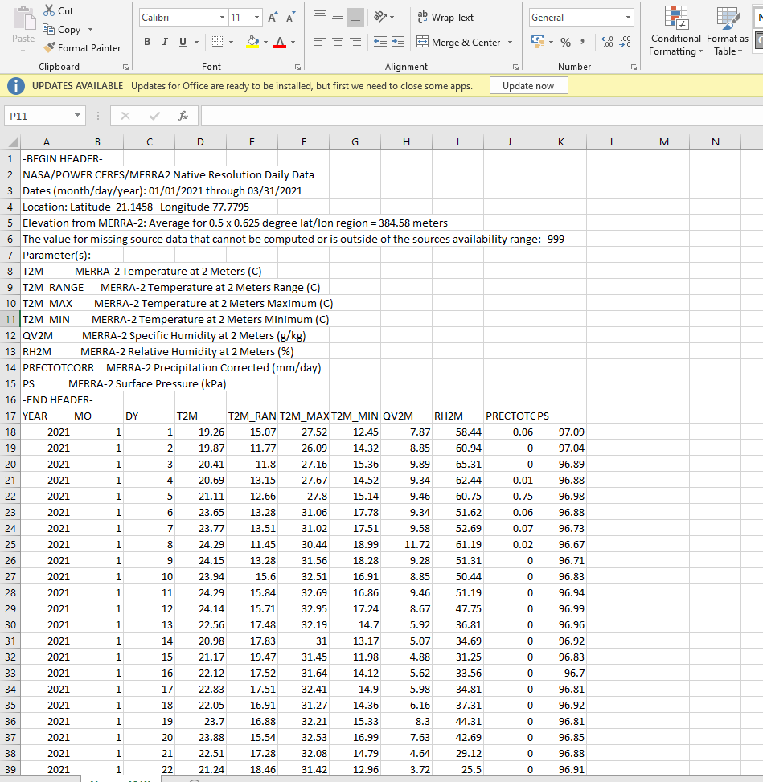
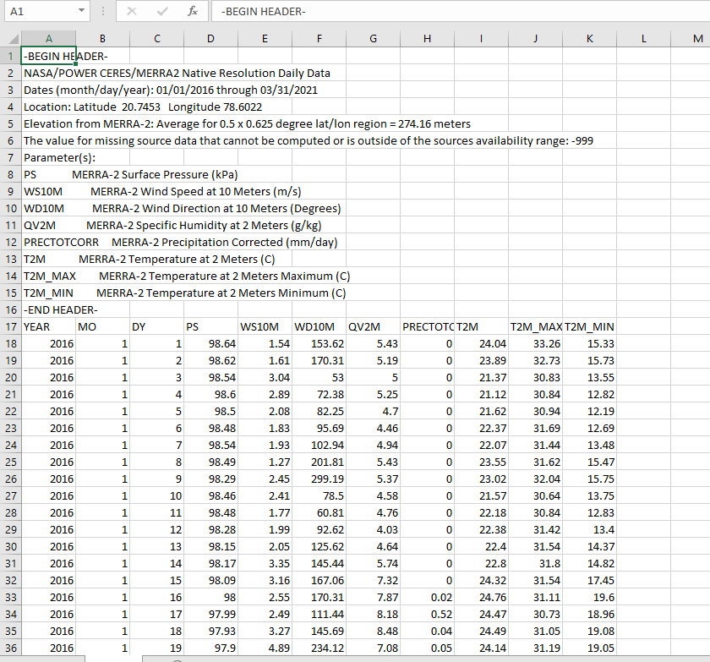
Some samples of gathered datasets

Slide 8

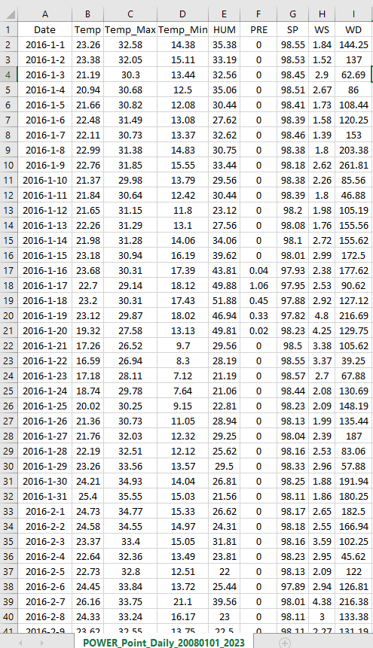
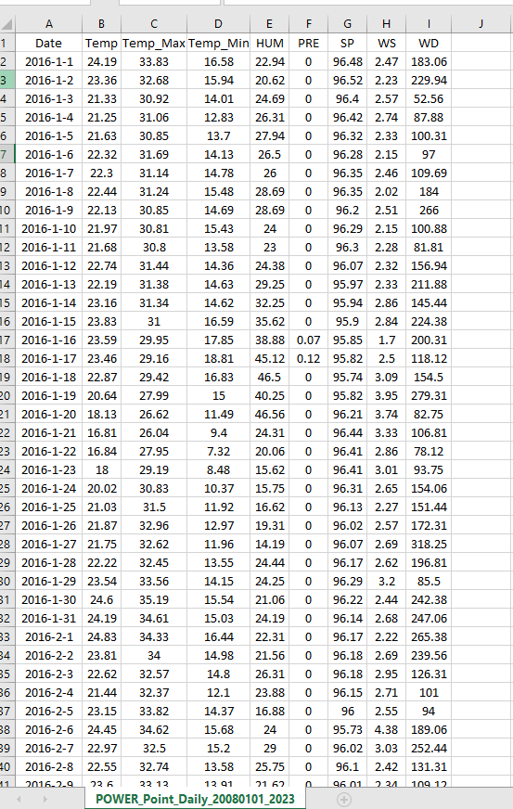
Sample of clean dataset

Slide 9
Restrictions while cleaning the datasets
Datasets must be organized Must have understandable namings Must not have any null values Null values will leave the visualization with unstable plotting's The datasets must be accurate for future predictions A single missing data cell can cause errors in future The data should be of more than 5 years for more accuracy.

Slide 10
Total Number of Data Gathered
Total Number of districts : 5
Total number of yearly data : 2016 – 2022
Total number of parameters : 9(may vary)

Slide 11

Thank You!

